Slide 1
Chapter 9 Customer relationship management

Slide 2
Management issues
What is the balance between online and offline investment for customer acquisition?
What technologies can be used to build and maintain the online relationship?
How do we deliver superior service quality to build and maintain relationships?

Slide 3
What is CRM?
How would you explain the terms:
CRM
e-CRM
Why does Centrica have a CRM function?
Why is CRM different?
What are benefits of this approach?

Slide 4
E-CRM – a definition
E-CRM is:
Applying – Internet and other digital technology… (web, e-mail, wireless, iTV, databases)
To – acquire and retain customers (through a multi-channel buying process and customer lifecycle)
By – Improving customer knowledge, targeting, service delivery and satisfaction.

Slide 5
Marketing applications of CRM
A CRM system supports the following marketing applications:
Sales force automation (SFA). Sales representatives are supported in their account management through tools to arrange and record customer visits.
Customer service management. Representatives in contact centres respond to customer requests for information by using an intranet to access databases containing information on the customer, products and previous queries.
Managing the sales process. This can be achieved through e-commerce sites, or in a B2B context by supporting sales representatives by recording the sales process (SFA).
Campaign management. Managing ad, direct mail, e-mail and other campaigns.
Analysis. Through technologies such as data warehouses and approaches such as data mining, which are explained later in the chapter, customers’ characteristics, their purchase behaviour and campaigns can be analysed in order to optimize the marketing mix.

Slide 6
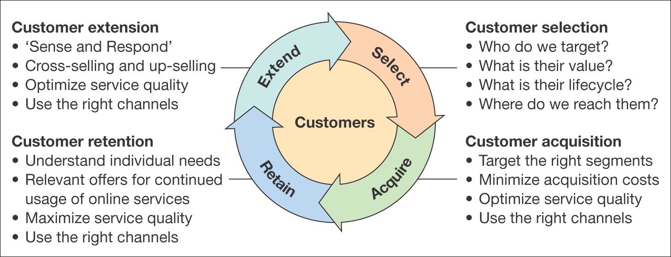
Figure 9.1 The four classic marketing activities of customer relationship management

Slide 7
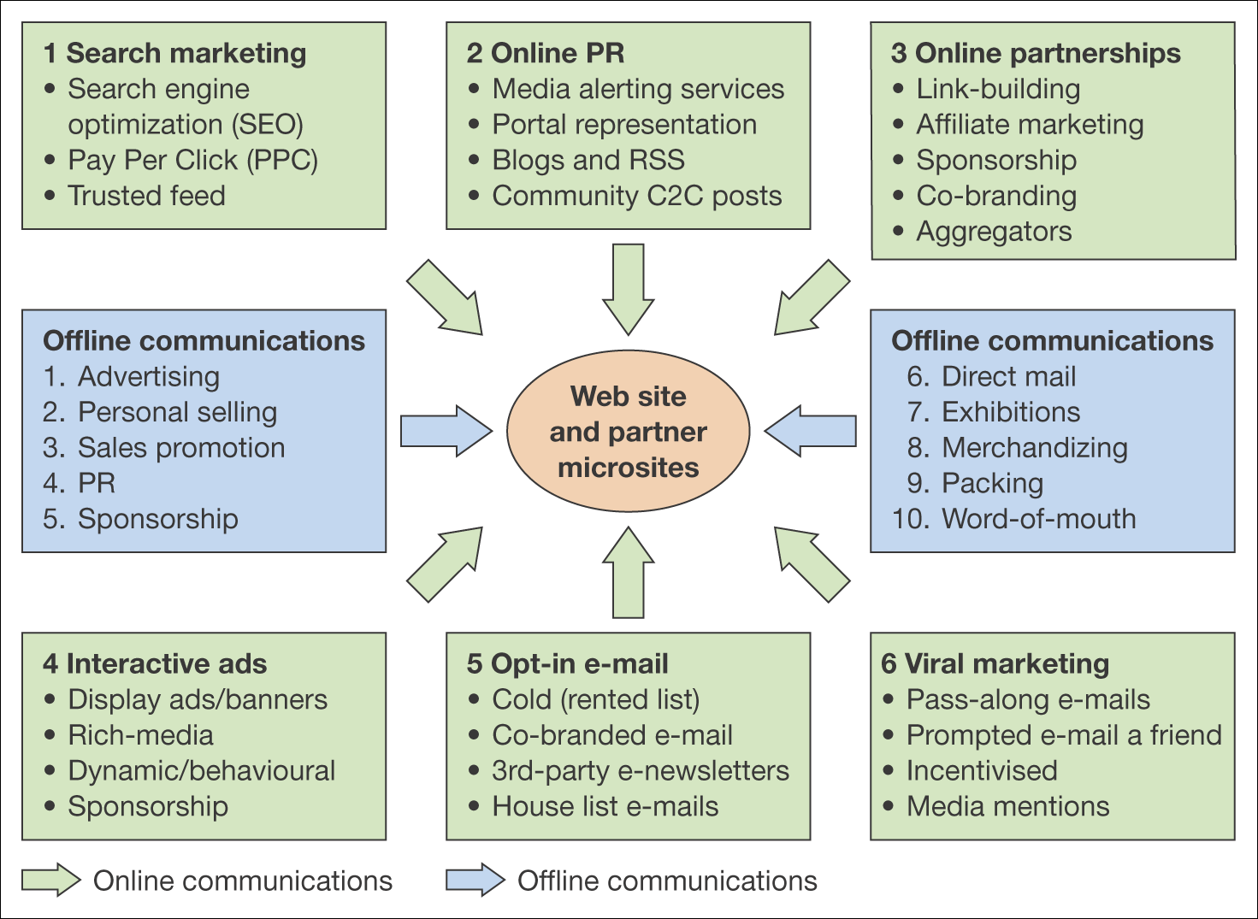
Figure 9.4 Online and offline communications techniques for e-commerce

Slide 8
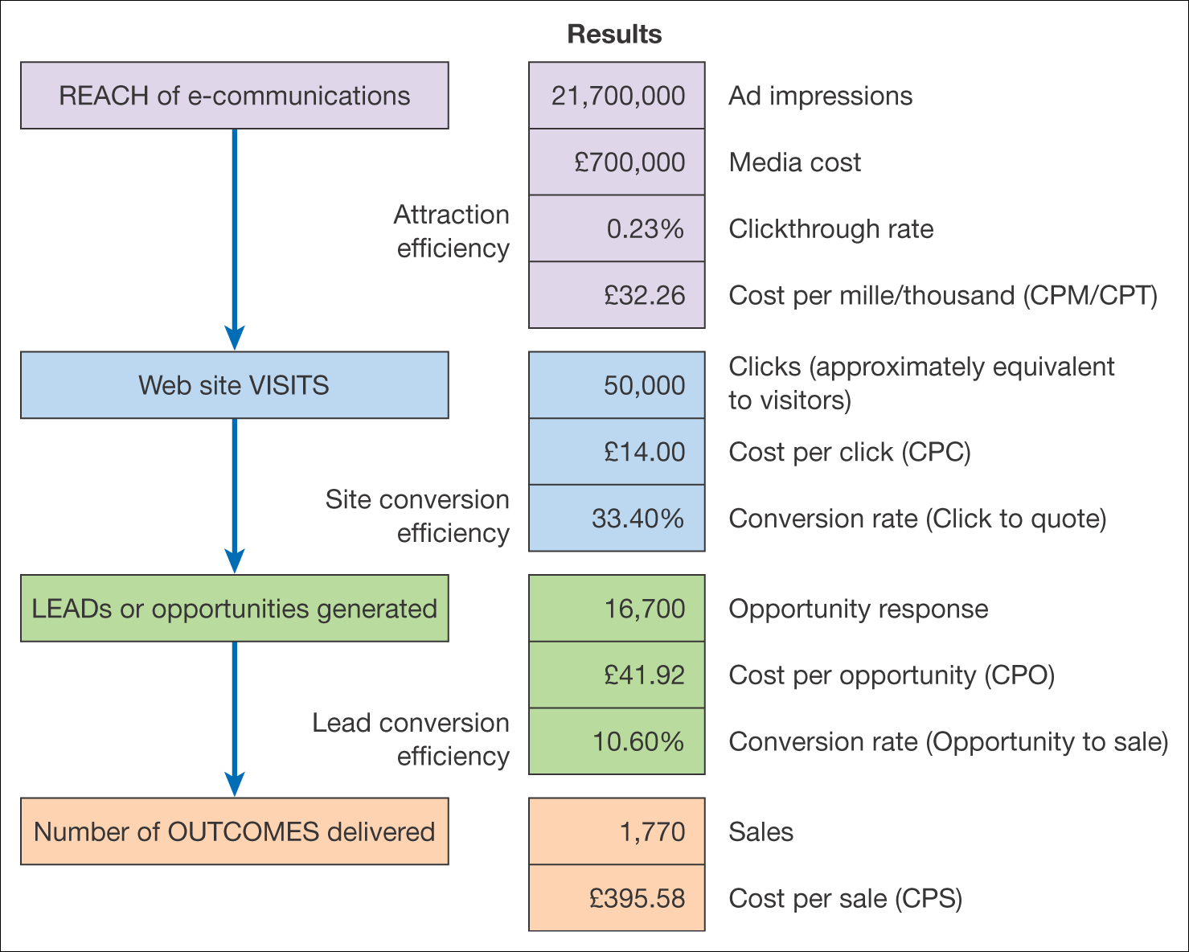
(in online advertising) cost per mille (the amount an advertiser pays a website per one thousand visitors who see its advertisements). "the average CPM rate for a music video online has increased tenfold"
Clickthrough rate = 50,000/21,700,000 = 0.23%
Cost per mille = 700000/21700 = 32.26
Conversion rate (click to quote)= 16700/50000 = 33.4%
Cost per click = 700,000/50,000 = 14.00
Conversion rate (opportunity to sale) = 1770/16700 = 10.60%
Cost per opportunity = 700,000/16,700 = 41.92
Cost per sale = 700,000/1770 = 395.58
CPM – Cost Per Mille – cost per 1,000 impressions.
CPC – Cost Per Click.
CTR – Click-through rate, the ratio of clicks to impressions. For example, if the number of impressions is 15,000 and the number of clicks is 30, then CTR=30/15,000=0.2%.
CPT – Cost Per Thousand – cost per 1,000 unique impressions.
Figure 9.7 An example of effectiveness measures for an online ad campaign
With an impression a user only sees an advertisement.
An engagement, or a click, happens when the user actually follows through and clicks on the ad.

Slide 9
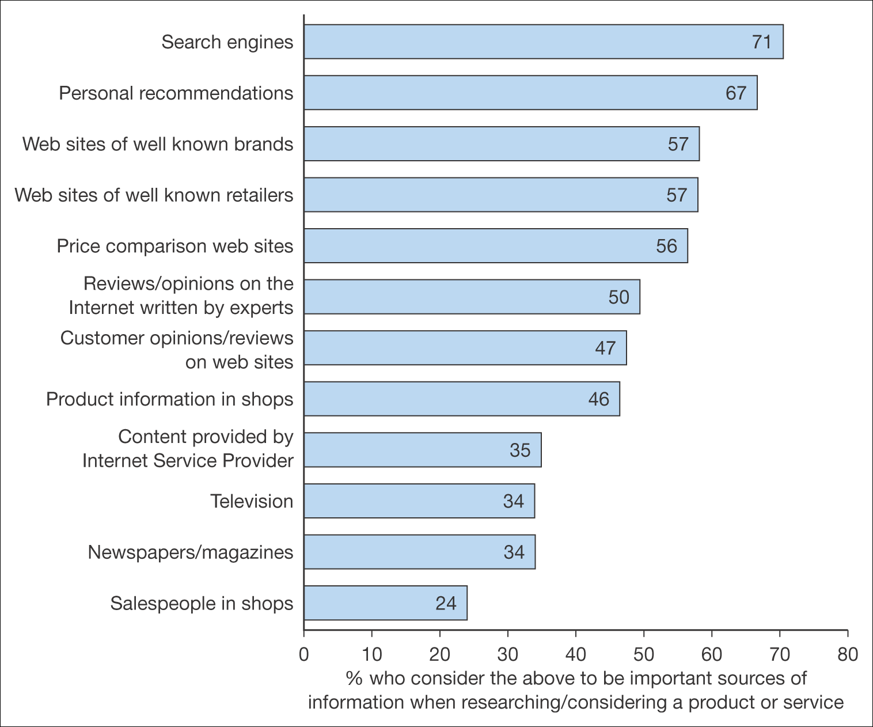
Figure 9.8 Percentage who consider the different information sources as important when researching/considering a product or service
Source: BrandNewWorld: AOL UK/Anne Molen (Cranfield School of Management)/Henley Centre, 2004

Slide 10
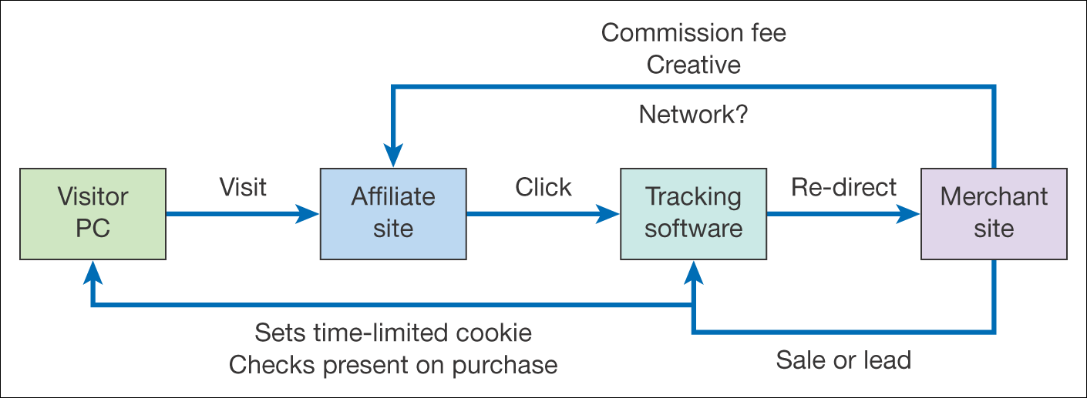
Figure 9.10 The affiliate marketing model
(note that the tracking software and fee payment may be managed through an independent affiliate network manager)

Slide 11
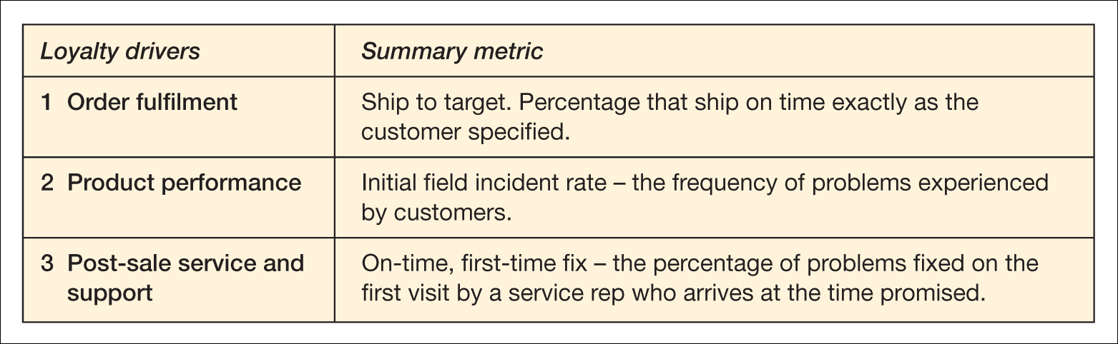
Table 9.4 Relationship between loyalty drivers and measures to assess their success at Dell Computer
Source: Reprinted by permission of Harvard Business Review from information on pp. 105–13 from ‘Your secret weapon on the web’, by Reicheld, F. and Schefter, P., in Harvard Business Review, July–August 2000. Copyright © 2000 by the Harvard Business School Publishing Corporation, all rights reserved

Slide 12
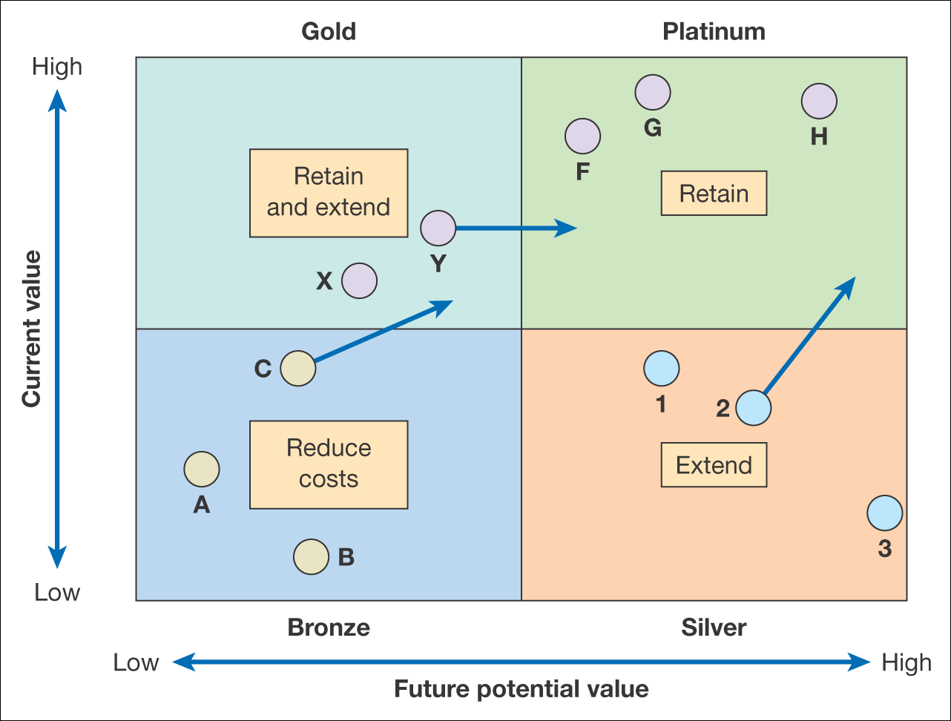
Lifetime Value, which means an estimate of the revenue generated by a customer during the time that the said customer maintains a commercial relationship with a business.
Figure 9.15 An example of an LTV-based segmentation plan

Slide 13
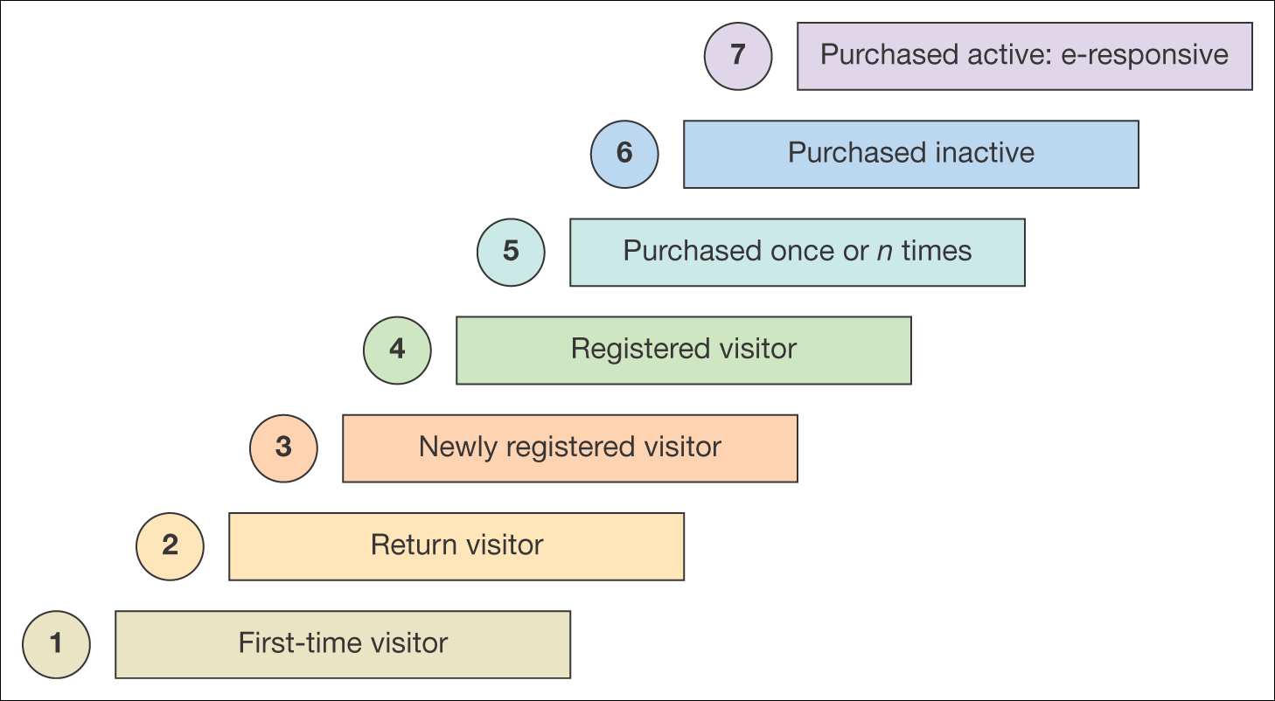
Figure 9.16 Customer lifecycle segmentation

Slide 14
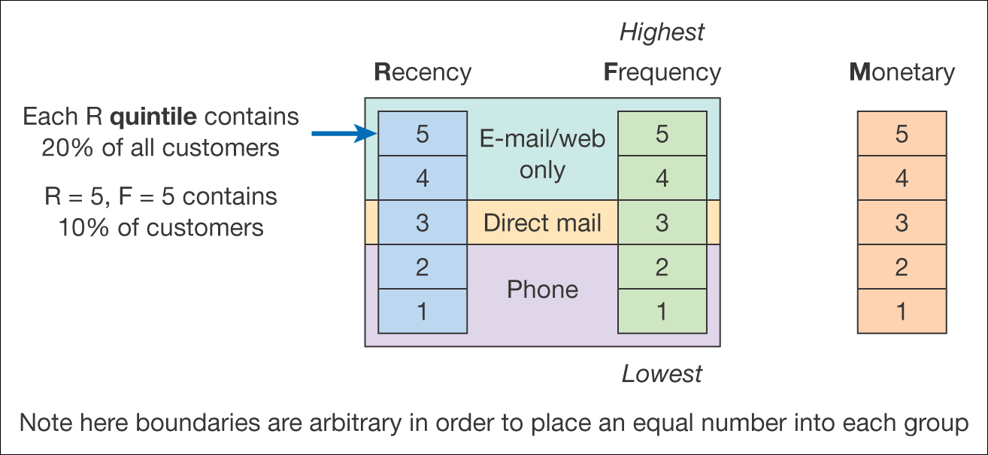
Figure 9.17 RFM analysis

Slide 15
RFM stands for Recency, Frequency, and Monetary value, each corresponding to some key customer trait. These RFM metrics are important indicators of a customer’s behavior because frequency and monetary value affects a customer’s lifetime value, and recency affects retention, a measure of engagement.
How to Implement RFM Analysis Used in Customer Segmentation
RFM analysis helps marketers find answers to the following questions:
Who are your best customers?
Which of your customers could contribute to your churn rate?
Who has the potential to become valuable customers?
Which of your customers can be retained?
Which of your customers are most likely to respond to engagement campaigns?

Slide 16
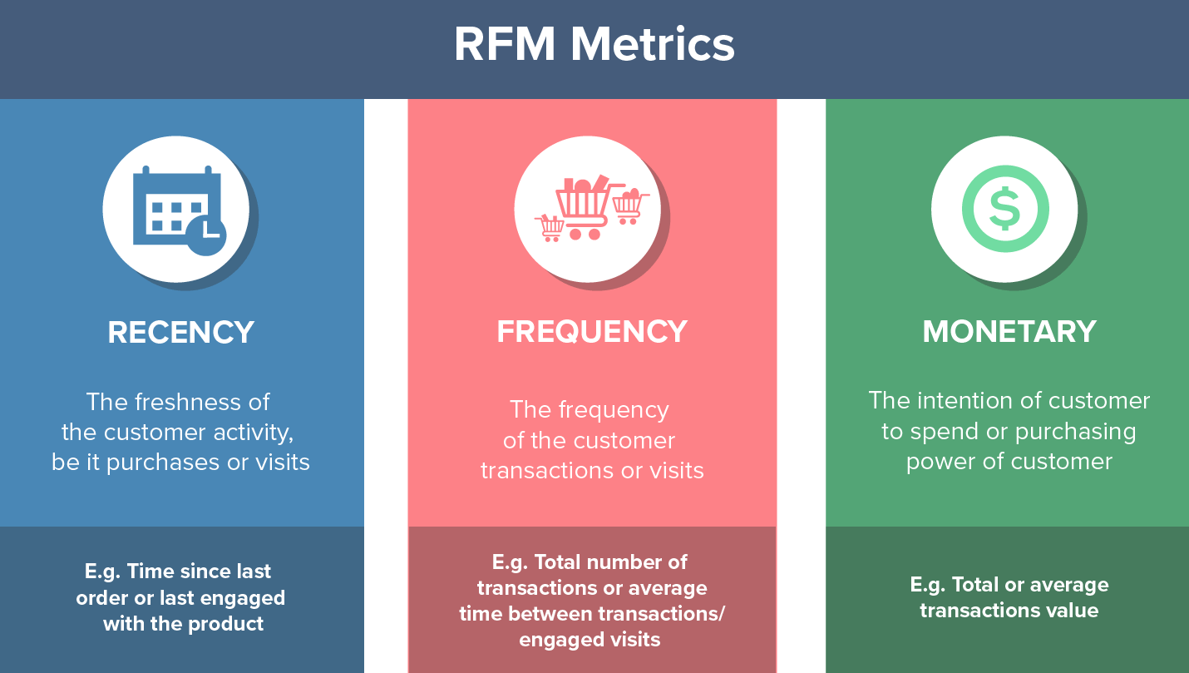

Slide 17
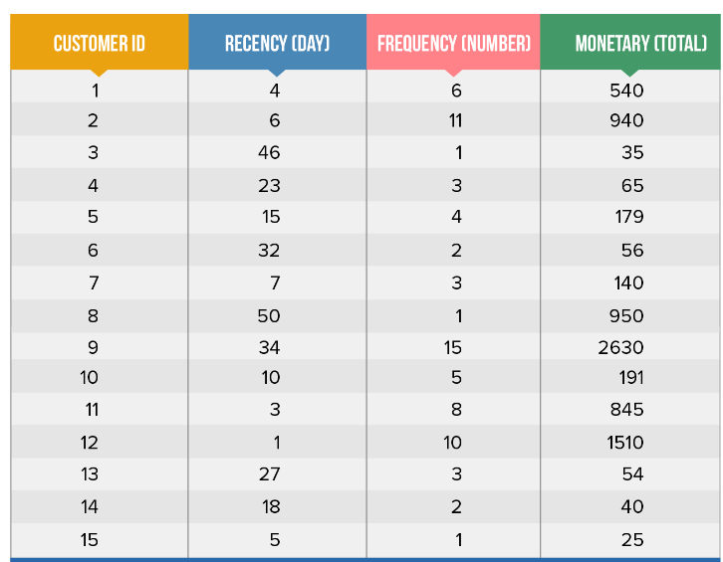
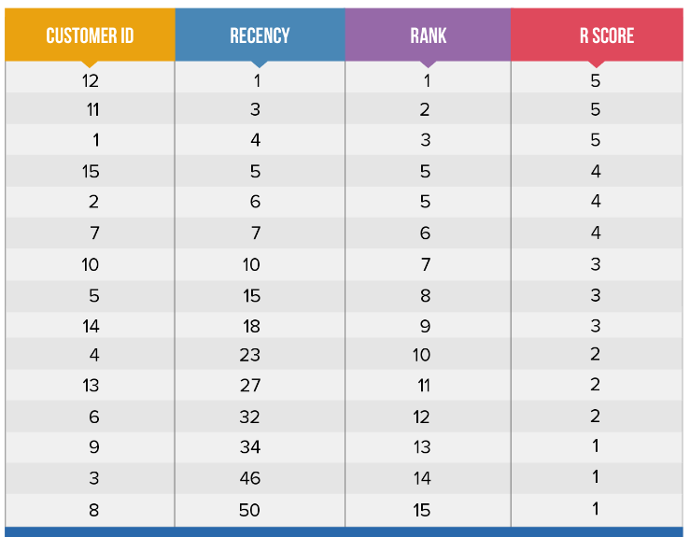
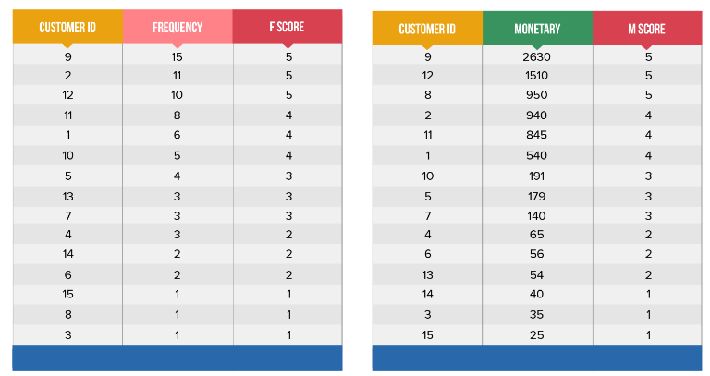
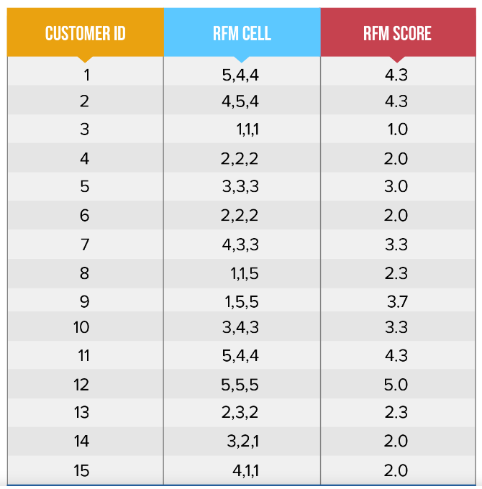

Slide 18
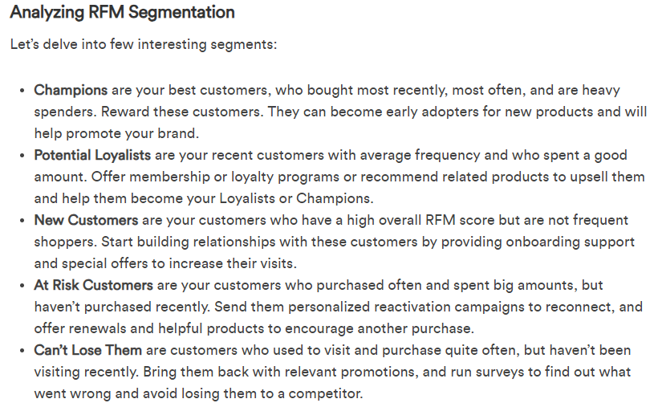
Select retain and extend
Select and extend
Select Acquire retain
Select and retain
Select, retain and extend

Slide 19
Figure 9.1 The four classic marketing activities of customer relationship management

Slide 20
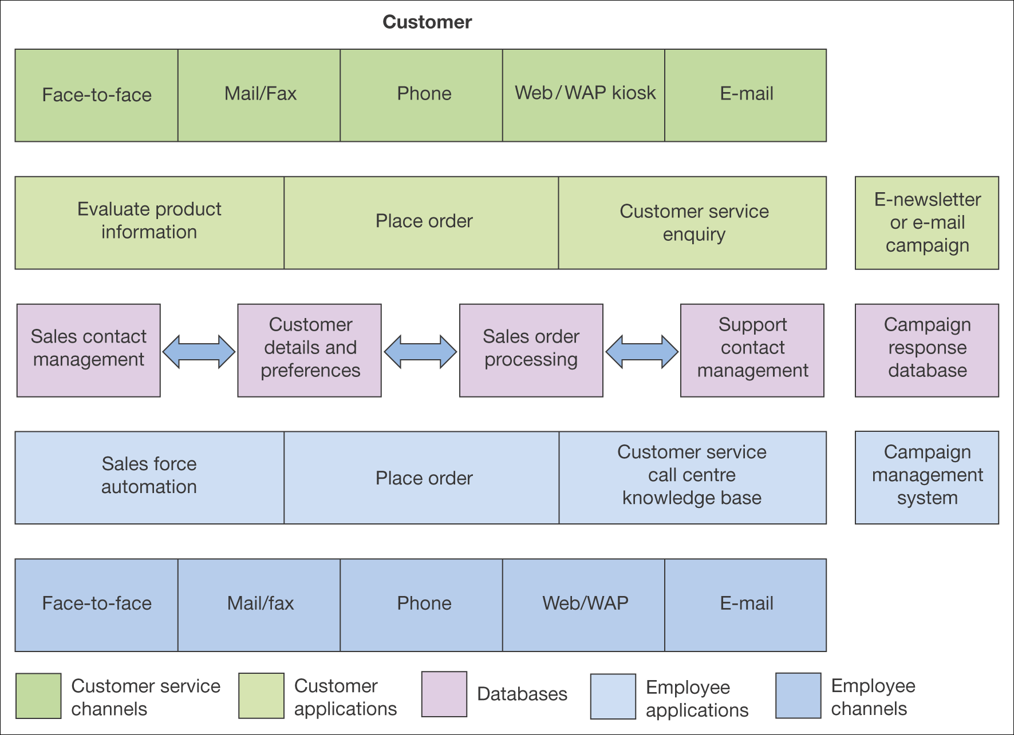
Figure 9.18 An overview of the components of CRM technologies

